Slide 1
LISAC Short Course Series INTRODUCTION TO R
Olawale Awe
February 2015
LISA: R Basics

Slide 2
Outline
What is R?
Why use R?
Installing R into your computer
Introduction to R studio
Data Structures, Manipulation and Sampling
Data Import
Exploratory Data Analysis
Loops
If/Else Statements
Data Export
LISA: R Programming Basics
Summer 2014

Slide 3
What is R?
R is an extensive, object-oriented programming language.
An integrated suite of software facilities for data manipulation, simulation, calculation and sophisticated graphical displays.
Started by Robert Gentleman and Ross Ihaka (hence “R”) in 1995
-as a free, independent, open-source implementation of the S programming.
It handles and analyzes data very effectively and it contains a suite of operators for calculations on arrays and matrices.
Currently maintained by the R Core development team – an international group of hard-working volunteer developers.
http://www.r-project.org
LISA: R Programming Basics
Summer 2014
LISA: R Basics
Fall 2013

Slide 4
Why use/Learn R?
R is FREE!
It contains many built-in functions and installable packages that will cover nearly every possible need you have.
R is flexible-you are not restricted to built-in functions.
You can write your own codes.
Interactive console makes testing and debugging easy.
LISA: R Programming Basics
Summer 2014

Slide 5
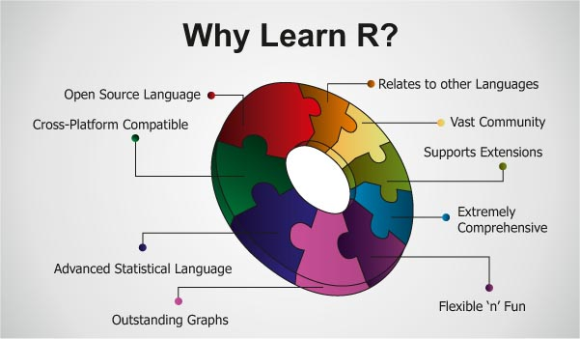
Source: http://www.edureka.in/blog

Slide 6
How to Install R on your computer?
Windows:
http://cran.r-project.org/bin/windows/base/
MacOs X:
http://cran.r-project.org/bin/macosx/
LISA: R Programming Basics
Summer 2014

Slide 7


Introduction to R- Studio
R
www.r-project.org
The engine
Rstudio
www.rstudio.org
The pretty face
An interface that makes working with R easier!
Notes:
R Programming Basics

Slide 8
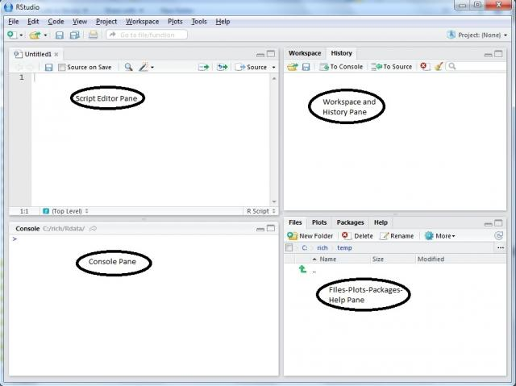
R Studio: Has 4 windows(panes)
Displays your scripts and codes.
Workspace
and history of commands
The console will display all your results and commands.
Available files, generated plots, package management and help

Slide 9
Data Structures and Manipulation
Object Creation
Expression: Allows you to write, evaluate and print your result on the screen.
Assignment: Storing the results of expressions by assigning it to a variable.
Vectors:
The basic data structure in R. (Scalars are vectors of dimension 1).
Creating sequences:
: command. Creates a sequence incrementing/decrementing by 1
seq() command.
Vector of numbers with no pattern. c() function.
Vectors of characters. Also use c() function with the help of “”
Repeating values. rep() function.
Arithmetic with vectors: All basic operations can be performed with vectors. Round(),sort(),length().
Subsets: The basic syntax for subsetting vectors is: vector[index]
Sampling from vectors/distributions.
LISAC: R Basics
Summer 2014

Slide 10
Random Sampling
We can draw a random sample from a vector of numbers/or characters using the sample command:
sample(vector,n,replace=T)-with replacement
Sample(vector,n,replace=F)-without replacement.
Sample(letters,n)-sample n letters from the 26 English alphabets.

Slide 11
Sampling from a Distribution
You can generate random samples from various distributions, e.g :
runif(n,min,max) : Uniform Distribution
rbinom(n,size,prob.) :Binomial Distribution
rexp(n,rate): Exponential Distribution
rpois(n,mean): Poisson Distribution
rnorm(n,mean,sd):Normal Distribution
etc.

Slide 12
Data Structures and Manipulation
Matrices: Objects in two dimensions.
Creating Matrices
Command: matrix(data, nrow, ncol, byrow).
Where data= list of elements that will fill the matrix.
nrow, ncol: number of elements in the rows and the columns respectively.
byrow: filling the matrix by row. The default is FALSE.
Some Matrix Functions
dim(): Lists the dimensions of the matrix.
cbind: Creating matrix by putting columns together.
rbind: Creating matrix by putting rows together.
diag(d): Creates identity matrix of dimension d.
LISA: R Programming Basics
Summer 2014

Slide 13
Data Structures and Manipulation
Some Matrix computations
Addition.
Subtraction
Inverse: function solve()
Transpose: function t()
Element-wise multiplication: *
Matrix multiplication: %*%
Subsets
Referencig a cell: matrix[r,c], where r represents the row and c represents the column.
Referencing a row: matrix[r,]
Referencing a column: matrix[,c]
LISAC: R Basics

Slide 14
Exercise 1: Prices Data Set (prices.csv)
The data are a random sample of records of resales of houses from Feb 15 to Apr 30, 1993 from the files maintained by the Albuquerque Board of Realtors.
Number of cases: 65
Variable Names:
PRICE = Selling price ($hundreds)
SQFT = Square feet of living space
AGE = Age of house (years)
NE = Located in northeast sector of city (1) or not (0)
LISAC: R Basics

Slide 15
Data Import
We need to set the working directory. For this we use the function setwd:
setwd(“location”)
Comma Separated Values:
Use the function read.table
mydatacsv<- read.table('prices.csv', sep=',', header=T)
Text File:
Use the function read.table:
mydatatxt<- read.table('prices.txt', sep='\t', header=T)
LISAC: R Basics

Slide 16
Practice 1.
Lets review some of the matrix commands we learned previously by applying them to our new dataset.
What is the dimension of our dataset?
Assign the value of the cell [2,3] to the new variable var1
Assign the value of the cell [10,4] to the new variable var2
Output the value of each column separately.
Assign the values of SQFT to a new variable SQFT.
Output the value of row 15.
LISA: R Basics

Slide 17
Exploratory Data Analysis: Summaries
Quantitative summary of variable SQFT. We will calculate the minimum, maximum, mean, variance, median for that variable.
mean(SQFT)
var(SQFT)
min(SQFT)
max(SQFT)
median(SQFT)
You can obtain the 5 number summary for the variable by using the command:
summary(SQFT)
LISAC: R Basics

Slide 18
Exploratory Data Analysis: Graphs
Histogram of SQFT
hist(SQFT, main="Histogram of square feet of living space", col="dodgerblue", breaks=10)
Boxplot of SQFT
Boxplot(SQFT, main="Boxplot of square feet of living space", col="khaki1", ylab=”SQFT”)
Boxplot of SQFT by NE .
boxplot(PW~mydatacsv[,4])
Normal Quantile-Quantile Plot
qqnorm(SQFT, main="Normal QQ Plot SQFT")
http://www.stat.columbia.edu/~tzheng/files/Rcolor.pdf
LISAC: R Basics

Slide 19
For Loops
This statement allows for code to be executed repeatedly.
for(i in 1:n){
statement
}
LISAC: R Basics

Slide 20
While Loops
This statement allows for code to be executed repeatedly while a condition holds true.
while(condition){
statement
}
LISAC: R Basics

Slide 21
If/Else Statement
if statement - use this statement to execute some code only if a specified condition is true:
if (condition) { statement }
LISAC: R Basics

Slide 22
If/Else Statement
if...else statement - use this statement to execute some code if the condition is true and another code if the condition is false.
if ( condition )
statement
else
statement2
LISAC: R Basics

Slide 23
If/Else Statement
if...else if....else statement - use this statement to select one of many blocks of code to be executed
if (condition){
statement1
} else{
if (condition2){
statement2
} else {
Statement3
}
}
LISAC: R Basics

Slide 24
Data Export: csv
If you have modified your dataset in R you can export it as a .csv file using the following code:
write.csv(mydatacsv,file="mydatacsv.csv")
Can also export vectors or other objects that you have created to .csv file:
write.csv(vec2,file="vec2.csv")
LISAC: R Basics

Slide 25
Data Export: txt
If you have modified your dataset in R you can export it as a space delimited .txt file using the following code:
write.table(mydatacsv,file="mydatatxt.txt", sep=" ")
You can export it as a tab delimited .txt file using the following code:
write.table(mydatacsv,file="mydatatxt2.txt", sep="\t")
LISAC: R Basics

Slide 26
Excercise 2:National Longitudinal Mortality Study Dataset
The variable content for each record on the file includes demographic and socioeconomic variables from the current population survey combined with the underlying cause of death mortality outcome and the follow-up time until death for records of the deceased or 11 years of follow-up for those not deceased.
The manual of the data and a complete variable description is attached in the course materials on our website.
LISAC: R Basics

Slide 27
Practice 2 a.
Read into R the dataset pubfile.csv.
Determine the dimensions of the dataset
Extract the variable povpct, income as percent of poverty level (column 35) as a new variable.
Extract the variable ms, marital status (column 5) as a new variable.
Obtain the minimum, maximum, mean, variance, median for the variable povpct and store them in separate variables.
Create a vector with the stored values from 4.
Create a histogram of povpct of a different color with 20 breaks.
LISAC: R Basics

Slide 28
Practice 2 b.
Create a boxplot of povpct of a different color.
Create a boxplot of povpct by ms with the same color for all boxes.
Create a boxplot of povpct by ms with the same color for the first three boxes and another color for the remaining three boxes.
Create a normal Q-Q plot for Sepal Length.
Using for loops count how many observations are there in a metropolitan area (smsast=1) (col 20) with an age lower than 15 (col 2).
Export your extracted variables as a .csv file and the dataset as a tab delimited .txt file.
LISAC: R Basics

Slide 29
Please don’t forget to fill the sign in sheet and to complete the survey that will be sent to you by email.
Thanks for coming!
LISAC: R Basics

